Slide 1






Team Quantum QTs
Theme : AI Financial Fraud Detection
Design a system for banks that utilizes multiple AI agents to monitor and analyze transactions in real time, flagging suspicious patterns indicative of fraud.
LETS GO
Built By:
AADITYA PANDEY
MOHIT GINGLANI
VEDANT KUMAR

Slide 2

Table Of Content
01.
02.
03.
04.
Introduction
Problem Statement
Solution/System Architecture
Frameworks/Technologies
05.
SWOT Analysis

Slide 3

Quantum QTs
Introduction
In today’s high-stakes financial environment, fraud detection is not just an option—it’s a necessity.
Our solution tackles this challenge by designing an integrated system that leverages multiple AI agents to monitor and analyze banking transactions in real time.

Slide 4

Quantum QTs
Problem Statement
PROBLEM STATEMENT
⚖️ Balancing Accuracy & False Positives
🙅 Limited Citizen Engagement
🕵️ Evolving Fraud Tactics
🔐 Data Privacy & Security Compliance
🤖 Multi-Agent Coordination Challenges
📊 Scalability & Infrastructure
🏛️ Integration with Legacy Systems
🔄 Real-Time Processing Constraints

Slide 5
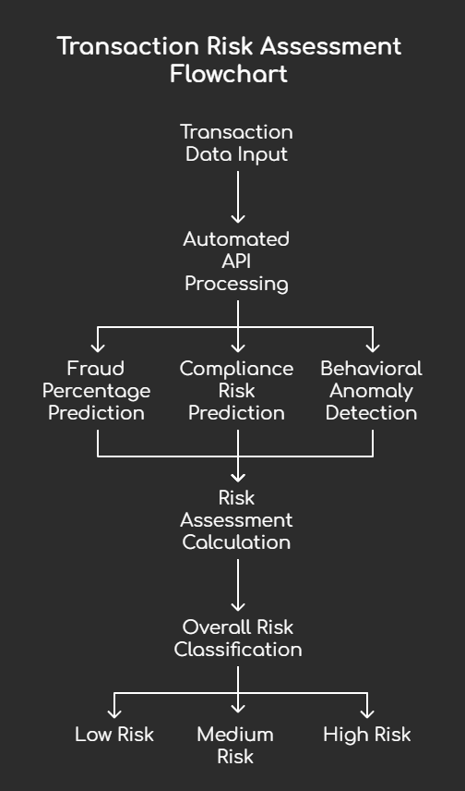
Solution
Quantum QTs
Dual Input Data Acquisition
Multi-Model Agentic AI Processing
Combines manual data entry for ad-hoc analyses with a robust automated, real-time API input, ensuring a comprehensive capture of transaction details.
Integrates outputs from seven specialized AI models—including ensemble methods for fraud detection, a fine-tuned GROQ for compliance risk, and advanced LSTM (with classical and quantum layers) for behavioral anomalies—to provide detailed risk assessments.
Risk Classification
Weighted Averages the outputs from these models to generate an overall risk score, classified into Low, Medium, or High categories, enabling decision-makers to prioritize and act on potential threats effectively.

Slide 6
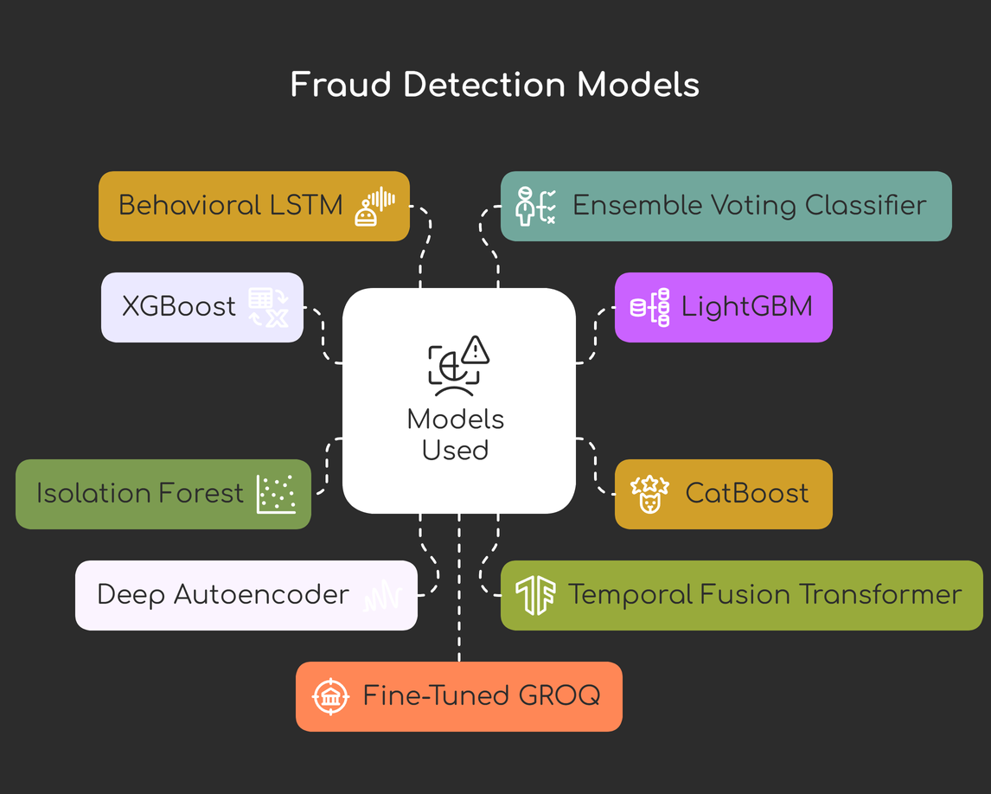
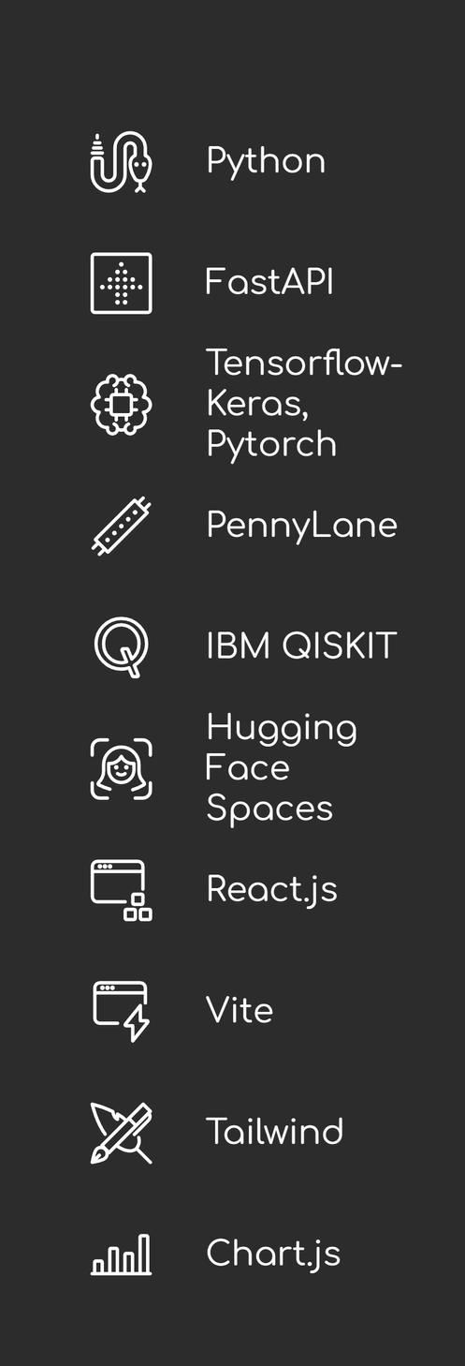
Frameworks & Tech
Quantum QTs
TECHSTACK, MODELS AND DEPENDENCIES USED

Slide 7
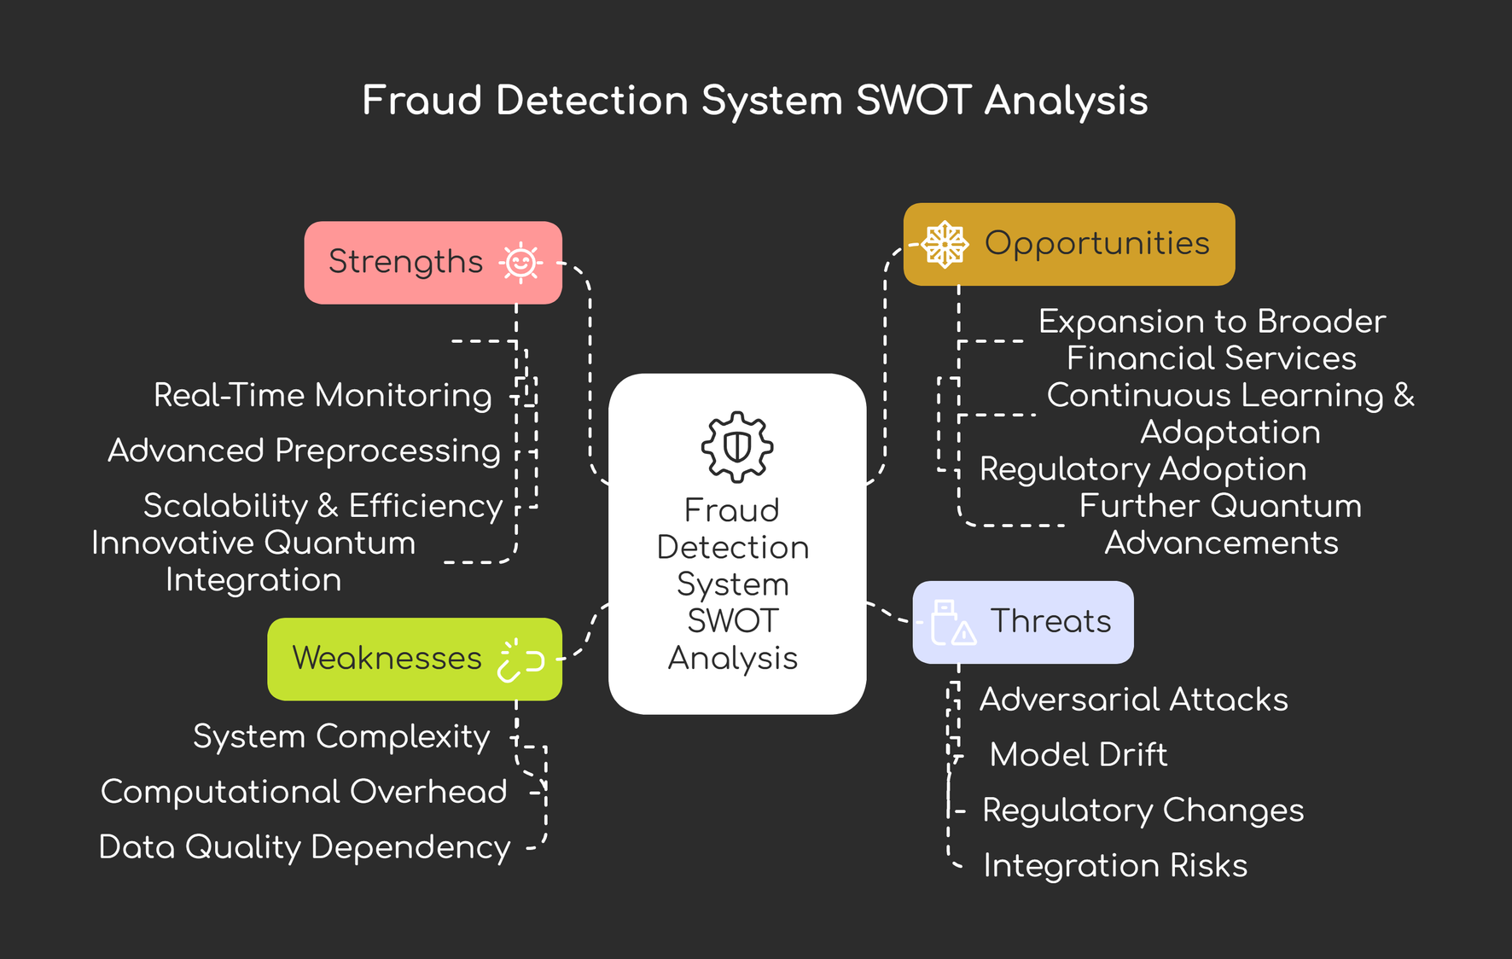
SWOT Analysis
Quantum QTs

